Slide 1
Alexa
Drone Pilot
Manush Parikh (17IT061)
Shrey Parekh (17IT059)
Rohan Modi (17IT056)
Guided By Sandip Patel

Slide 2
Flow
Overview
Understanding the problems
Project objective
Project Cycle
Project timeline

Slide 3
Motivation for Choosing this Project
This Project gives me a chance to understand various AWS services and helps us for enhancing our resources. This project tends to solve problems of the range driven drone, if we configure the service over cloud and have a high maintenance mobile computing module. It will be easier to control and increase the range of the drone which is the modern day challenge.

Slide 4
Overview
The project intends to control the drone with amazon alexa. Background of the project is to understand the AWS management Console and implement these services. The connection is through mobile SNS service of AWS and Alexa Skill that generate API calls to AWS Lambda Function and that further triggers the SNS service , Cognito - a AWS service which is used for authentication of mobile pool request over the SDK.

Slide 5
Understanding the problems
01
Understanding how the drone can be control via mobile SDK and various services of AWS.
02
Developing Alexa Skill to control the drone with voice based command over the server and using the Lambda function to compute triggers and provide those triggers the endpoint.
03
Developing the Cognito service and implementing the mobile SDK and publishing the Alexa Skill.

Slide 6
Project Cycle
04
Alexa Skill
Publishing the Structure and AWS Architecture
01
03
Lamdba function and SNS
Cognito Setup and Mobile SDK
02

Slide 7

Insights of the Project
Limitation of the project is basically connectivity issue, range for the control and various hardware infrastructure.
Improving the Range of the controller and reducing the hardware specifications with AWS Services.

Slide 8
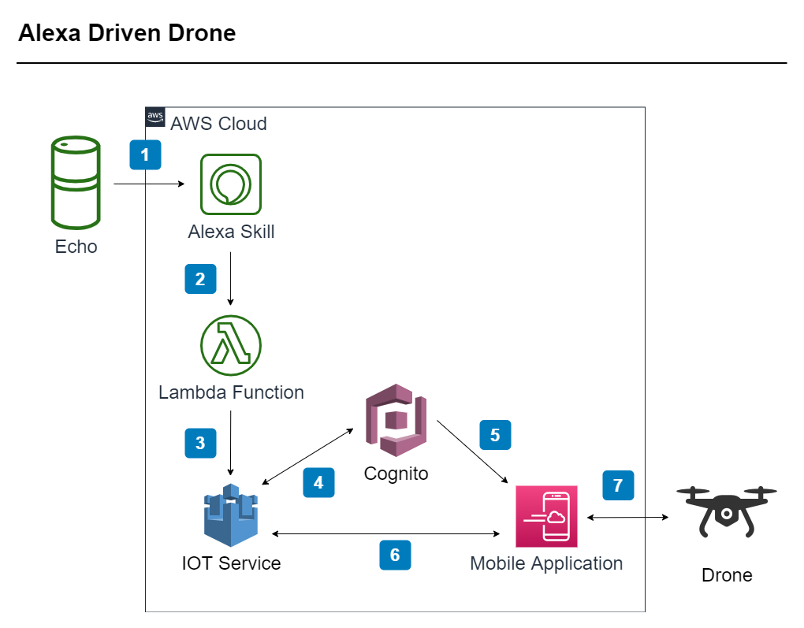
Flow Diagram of the Project

Slide 9
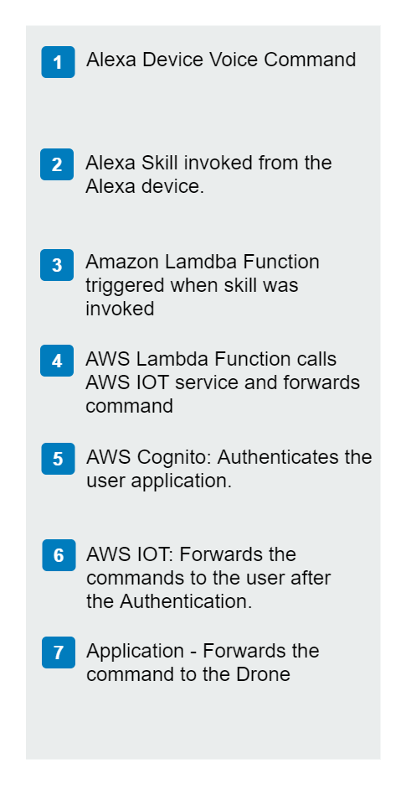
Process Flow of the Project

Slide 10


Tools And Technologies:
Alexa
Drone
Mobile
AWS Account
Alexa Skill

Slide 11
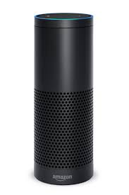
Functional Requirements
Non-Functional Requirements
Voice Control of the Drone
App configuration
Alexa Skill
Develop Utterances
Cognito Authentication
High Availability
Scalable to multiple API invocation
More secure linkage
More security over the drone network
Authentication can be done in AWS console based on IAM Role

Slide 12
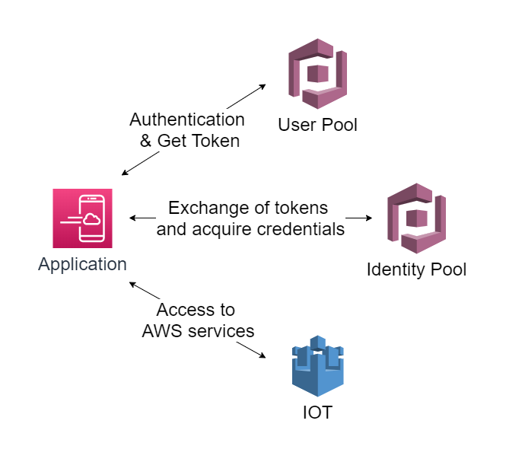
AWS Cognito

Slide 13
Learning
This Project made us aware about the available services and Cloud Structure. I learned to develop Alexa Skill and apply concepts of mobile computing. We learned about authentication using Coginto and how can we use android sdk for the same.

Slide 14
Future Scope
Extending the project over real environment and applying it to fleet of drones and increasing the security of the calls and invocation. Implementing surveillance system using drones which can be controlled by voice commands.

Slide 15
Project timeline
DEC
JAN
FEB
MAR
APR
Understanding the problem
AWS Console Management
Alexa Skill Kit Development
Configuring mobile sdk with sns endpoint using cognito
Lambda Function, SNS Service Configuration and Understanding Cognito

Slide 16
REFERENCES:
https://developer.amazon.com/alexa/console/ask/build/custom/amzn1.ask.skill.b5ec958f-cbbd-46ea-bdfb-9ae937f69d96/development/en_US/endpoint
https://www.awseducate.com/student/s/awssite
https://docs.aws.amazon.com/lambda/latest/dg/lambda-java.html
https://docs.aws.amazon.com/

Slide 17
Thank you!

